Slide 1
[Project]
Session One:
An Introduction to user research

Slide 2
The project
Understand the role of digital identity in accessing government services among 16-20 year olds.
Next sessions:
Framing your research
Tools and methods
Structuring interviews
Structuring questions
Synthesis and analysis
Notes:
Industrial design background - curiosity into how things work
Design anthropology - why is super important - you can always design different chairs but why do we need another chair
How can design improve patient dignity and privacy in hospitals
Masters the culture of looking after others belongings
Worked at TACSI doing user research …

Slide 3

Example: Houston Airport
Notes:
Icebreaker - how long have you been doing user research? how confident are you doing user research?
Introductions
What do you hope to gain from these sessions?

Slide 4
Mastering a craft
Kinds of craft
Inner Craft - reflecting, connecting, holding
Thinking Craft - conceptualising, illuminating, mapping, analysis,
Organising Craft - convening, modelling, galvanising
Building Craft - creating, modelling, explifying, iterating, manifesting
Subheading
Acquisition
Knowledge transfer
Student > Apprentice > specialist > Expert > Master
Novice > advanced beginner > Competent > Proficient > Expert > Master
Awareness > training > Practice > Master
Discover > Training > Practice > Experience > Mentor
Jedi metaphor 1
Notes:
A lot of user research is as simple as going and talking to people but its the intention behind why and what you talk about that really matters.
Purpose of these sessions - consistency, exposure to new methods, sharing knowledge, reflection and building confidence.
User reasearch is hard becuase it required many types of craft (see break down) - run this as an activity where people can show their prioritise their strongest crafts

Slide 5
What we’ll cover
This session:
Learning a craft
Purpose of user research
Types of user research
Considerations
Getting started
Next sessions:
Framing your research
Tools and methods
Structuring interviews
Structuring questions
Synthesis and analysis

Slide 6
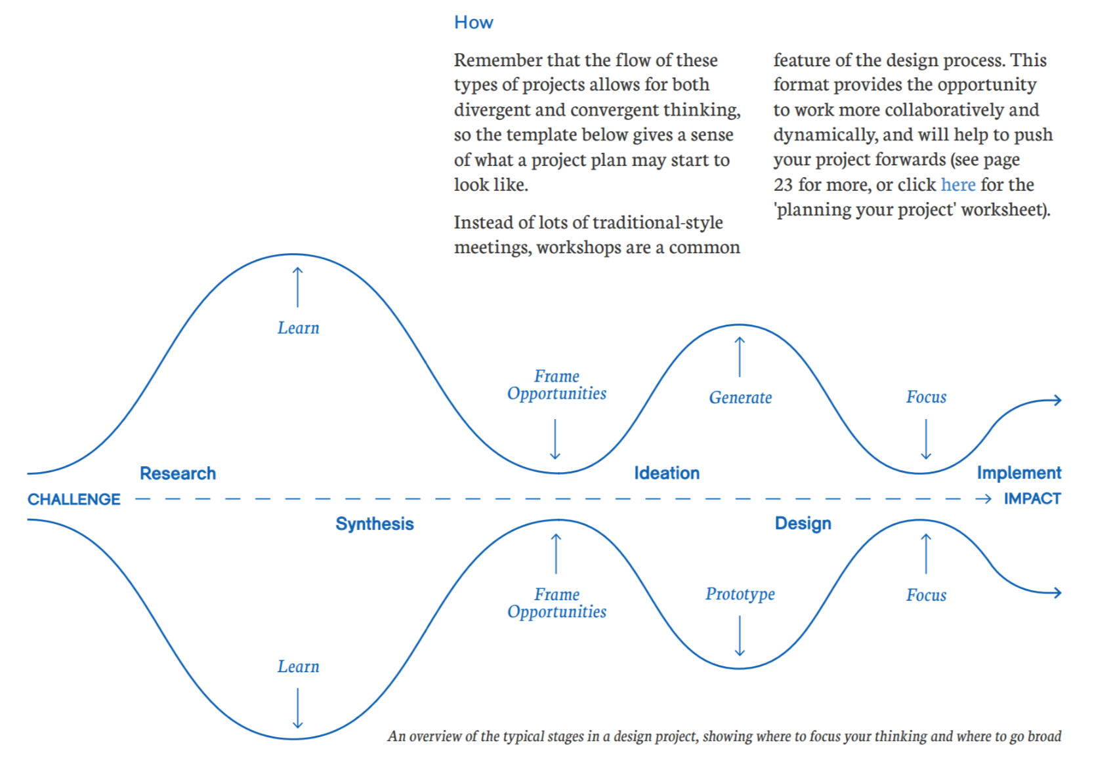
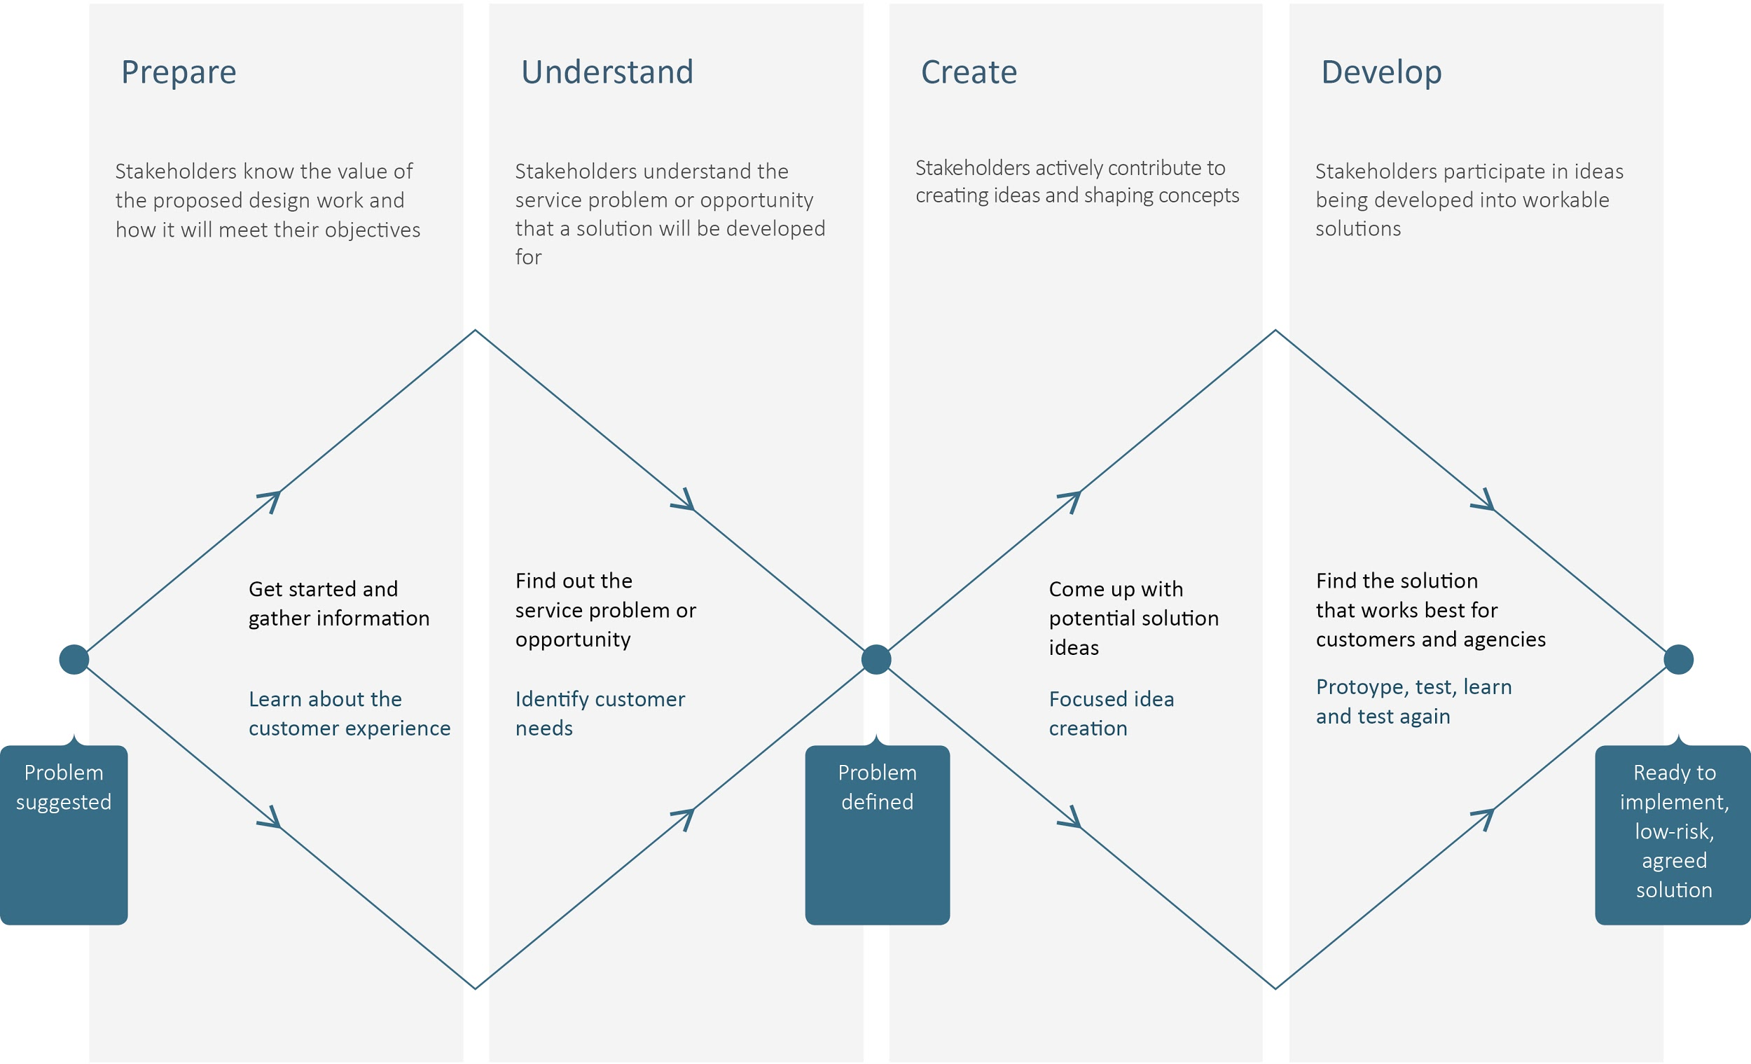
Why do user research?
Define
Empathise
Prototype
Ideate
Test
Quotes here from awesome people
Reference: Stanford d.School
Notes:
Throughout the session I will be referring to applying these methods within a discovery phase of research as they are often adapted during user testing.
To uncover needs that people have which they may or may not be aware of (stanford)
Dpmc guide

Slide 7
Reasoning
Fernando
Playpumps

Slide 8
Assumptions
Evidence + Empathy
Notes:
Definition of an assumption and dangers of assumptions
Going from unknowns to knowns

Slide 9
Types of user research
Conversational
Say, think, do, feel
Card sorting
Day in the life
Mapping
Observational
Ethnography
Walking Tours
Shadowing
Projectional
Cultural Probes
Story making
Prototyping
Say, think, do, feel
Scenarios
Notes:
We will focus on conversational methods in these sessions as they widely used however we will discuss how to incorporate other methods into your approach and can always explore future sessions on specific methods such as Observations and shadowing.

Slide 10
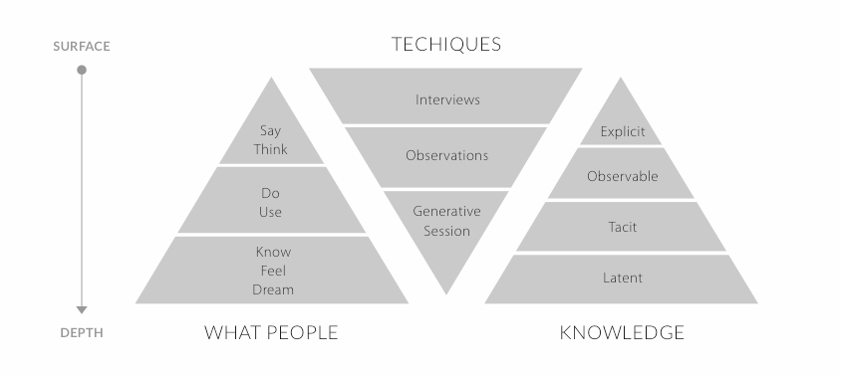
Going Deep
Reference: Liz Sanders
Notes:
Why it’s important to use multiple methods and spend time learning from people.
Validating what you see or people say
Context and environment
Rapport and trust - we’ll cover these in more detail in another session

Slide 11
Examples?
FbyF
Houston Airport

Slide 12
Considerations
Text here from doc

Slide 13
Getting started
Margs process steps here
Notes:
Have a clear goal of what you want to understand and why
Look before you do - what’s been done before?
Try start from somewhere interesting - whats non obvious
Seize the opportunity and use people's time wisely
Statement of work
Info sheet

